Slide 1

FILE EXPLORER!
Guided by: Bhabani Sankar Sahoo
Presented by: Priyanka Pradhan
Subhasmita Sahoo

Slide 2
-:CONTENTS:-
Introduction
Objectives
Methodology
Benefits or advantages
Technology
Future scope
Conclusion
References

Slide 3
INTRODUCTION
.File explorer is a software application that allows users to manage & navigate files &directories on a computer system.
.File explorer is previously known as Windows explorer.
.It is interacting with files,folders,&drives,making it easy to organize access and manage digital content.

Slide 4
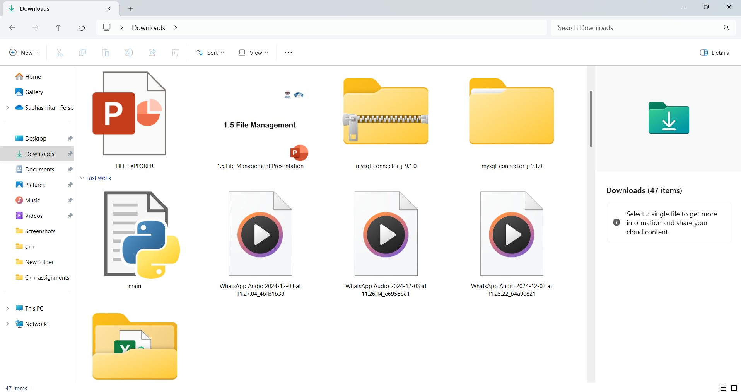
OBJECTIVES:-
→ Allow users to easily navigate through directories and subdirectories.
→Provide options for creating, deleting, renaming, and view files & directories.
→Allow users to view file contents, properties, and metadata.

Slide 5
-METHODOLOGY-
list_directory
view_file
delete_file
rename_file
change_directory
Handels listing files and directories.
Displays the content of a text files.
Deletes a specified file.
Renames a specified file.
Move for one file to another file by the help of path.

Slide 6
BENEFITS & ADVANTAGES:-
BENEFITS
ADVANTAGES
The file explorer works by giving you access to all of your computer’s folders and files.
It helps important documents in one place.
File handling design is simpler than database design.
It provides a intuitive way to manage files, it is an essential tool for anyone who uses a computer.

Slide 7
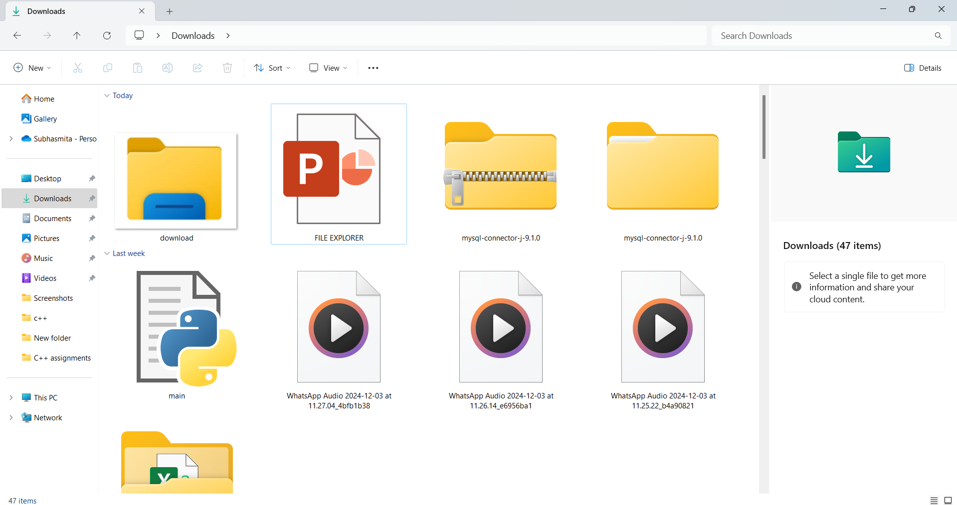
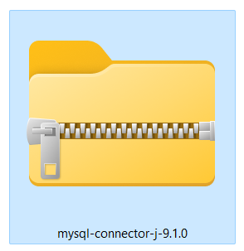
TECHNOLOGY:-
→Python programming language
→Python standard library module(OS)
→File handling
→Exception handling
→Command-Line interface
→Modular programming
→Windows

Slide 8
FUTURE SCOPES:-
Implement a GUI using frameworks like Tkinter ,kivy for better user interaction.
Add color-coded outputs or a menu system for better readability in the terminal.
Allow users to create copies of files in the same or different directory.
Also allow users to write mode.
Add functionalities for file backup & recovery.

Slide 9
CONCLUSION:-
File explorer is a crucial tool for managing & navigating files & directories on a computer system.
It provides a user-friendly with features like search functionalities, customization, and integration , File explorer makes it easy for users to organize & manage their files.

Slide 10
REFERENCES
.http://www.google.com
.http://www.youtube.com
.http://www.chatgpt.com
.http://www.MetaAI.com
.http://www.gemini.com

Slide 11
THANK YOU!

